Slide 1

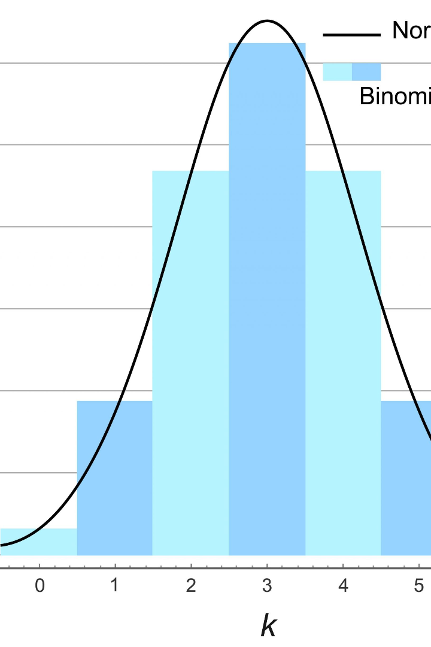

Binomial Distributions and its Applications
In probability theory and statistics, binomial distribution is a discrete probability distribution of the number of successes in a sequence of n independent experiments. It has various real-life applications and implications in the field of research and decision making.
T
by Tanishq Sriramoju

Slide 2

Definition of Binomial Distributions
The binomial distribution is defined as a probability distribution that represents the number of successes in a fixed number of independent Bernoulli trials, each with the same probability of success.

Slide 3
Properties of Binomial Distributions
1
Two Outcomes
2
Fixed Number of Trials
Binomial distributions have only two possible outcomes - success or failure - for each trial.
The number of trials, denoted by 'n', is fixed and predetermined in binomial distributions.
3
Independent Trials
4
Constant Probability
Each trial is assumed to be independent, meaning that the outcome of one trial does not influence the outcome of another.
The probability of success, denoted by 'p', remains constant for all trials.

Slide 4



Examples of Applications in Real Life
Coin Flips
Election Voting
Quality Control
The probability of getting heads or tails in multiple coin flips can be modeled using binomial distributions.
Estimating the probability of a certain candidate winning based on voter preferences can be analyzed using binomial distributions.
Assessing the number of defective items in a sample during quality control can be analyzed using binomial distributions.

Slide 5

Uses of Binomial Distributions in Statistics
Hypothesis Testing
Confidence Intervals
Binomial distributions are utilized in hypothesis testing to determine if observed data supports or rejects a null hypothesis.
Calculating confidence intervals can involve using binomial distributions to estimate the probability of an event occurring.
Sampling Techniques
Sampling techniques often utilize binomial distributions to estimate population parameters and infer conclusions.

Slide 6

Comparison of Binomial Distributions with Other Probability Distributions
1
Binomial Distribution
Deal with discrete outcomes and a fixed number of trials.
Normal Distribution
2
Deal with continuous outcomes and are used for data that follows a bell-shaped curve.
3
Poisson Distribution
Deal with rare events and describe the number of events occurring in a fixed interval of time or space.

Slide 7
Limitations of Binomial Distributions
1
Independent Trials Assumption
2
Fixed Number of Trials
3
Constant Probability Assumption
The requirement of a fixed number of trials limits the application of binomial distributions in cases where the number of trials is unknown.
Binomial distributions assume that each trial is independent, which may not always be the case in real-world scenarios.
Binomial distributions assume that the probability of success remains constant across all trials, which may not hold true in some situations.

Slide 8

Conclusion and Summary
Binomial distributions play a crucial role in probability theory and statistics. They are widely used for modeling and analyzing discrete random variables with fixed number of trials and constant probability. Understanding their properties, applications, and limitations can provide valuable insights in various fields.

